Slide 1

Workshop setting goals

Slide 2
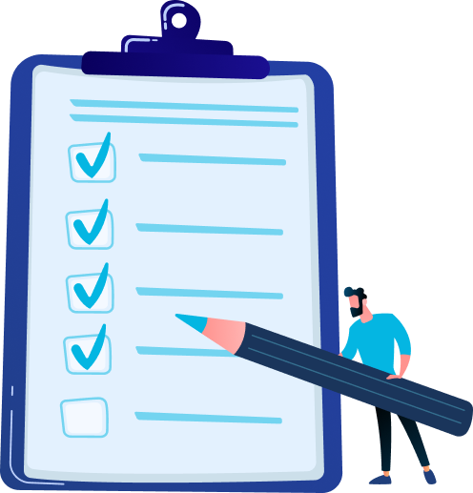
Programm
Why set goals
Tips for goal setting
Set your performance goals
Set your development goals
Put your goals into Dialog, reflect and ask for feedback
Next step: Meeting with your supervisor

Slide 3

Why set goals?
Encouraging personal development
Letting people do what they do best
Achieving team and organisational goals

Slide 4



Tips for setting goals
Keep it simple
Start small
(bring focus)
Your plan doesn’t have to be perfect
What are you focusing on in your daily work?
Begin with 1 or 2 goals and add new goals later.
You can refine your goals over time.

Slide 5

Create a personal plan
Performance goals
What do you want to achieve or accomplish?
Development goals
What do you want to develop or grow in?
Keep your goals top of mind
How often do you want to be reminded of your personal plan?

Slide 6

Inspiration for your performance goals
Dialog provides inspiration based on your current position and how you can contribute to team and/or organisational goals
Or ask yourself these questions:
  What is expected of you in your role or position?
  What else do you enjoy doing?
  Where do you spend a significant amount of time in your work?
  What is truly important in your job?
  What projects or assignments are you currently working on?

Slide 7
Inspiration for your development goals
Dialog provides inspiration from competencies, core values, and development questions.
Or ask yourself these questions:
  Where are you already proficient but want to improve even further?
  Where are you currently weaker and want to enhance your skills?
  What can you learn to become even better at your job?
  How can you maintain high-quality work performance?

Slide 8
Working out your goals
Write down 2 to 3 goals on a notepad
Name goal
Keep the name short and powerful (maximum 6 words)
Goal description
What exactly do you mean by your goal?
Why do you want to achieve this goal?
Who can help you in reaching your goal?
Breaking it down into steps
What is needed to successfully accomplish your goal?

Slide 9
Let's get started in Dialog
Add your performance goals
Add your development goals
Reflect on your goals (smileys)
Ask for feedback on your goals

Slide 10
Next step
When is your personal plan ready?
Plan a 1-on-1 with your supervisor
Reflect on your goals (smileys + updates)
Regularly ask your colleagues for feedback

