Slide 1

Evaluation and [ORGANISATION]

Slide 2
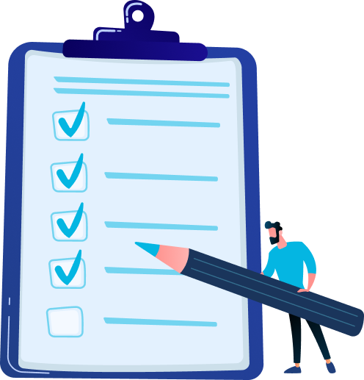
Program
Importance of evaluation conversations
Evaluation process and expectations
Evaluation conversations with Dialog
Next steps: scheduling meetings
Questions

Slide 3

Importance of evaluation conversations
Foundation for personal growth
Development of your team
Engaging and retaining employees

Slide 4

Evaluations in Dialog

Slide 5



Evaluation process & expectations
Planning & preparation
You will schedule the conversations with the employees.
Both parties will prepare for them using Dialog.
Conversations
You will conduct the conversations with your employees.
All conversations will be completed by DATE.
Wrap-up
After the conversation, you will complete the evaluation in Dialog.

Slide 6

Preparing for evaluation
Both the employee and the manager will prepare for the evaluation in Dialog.

Slide 7
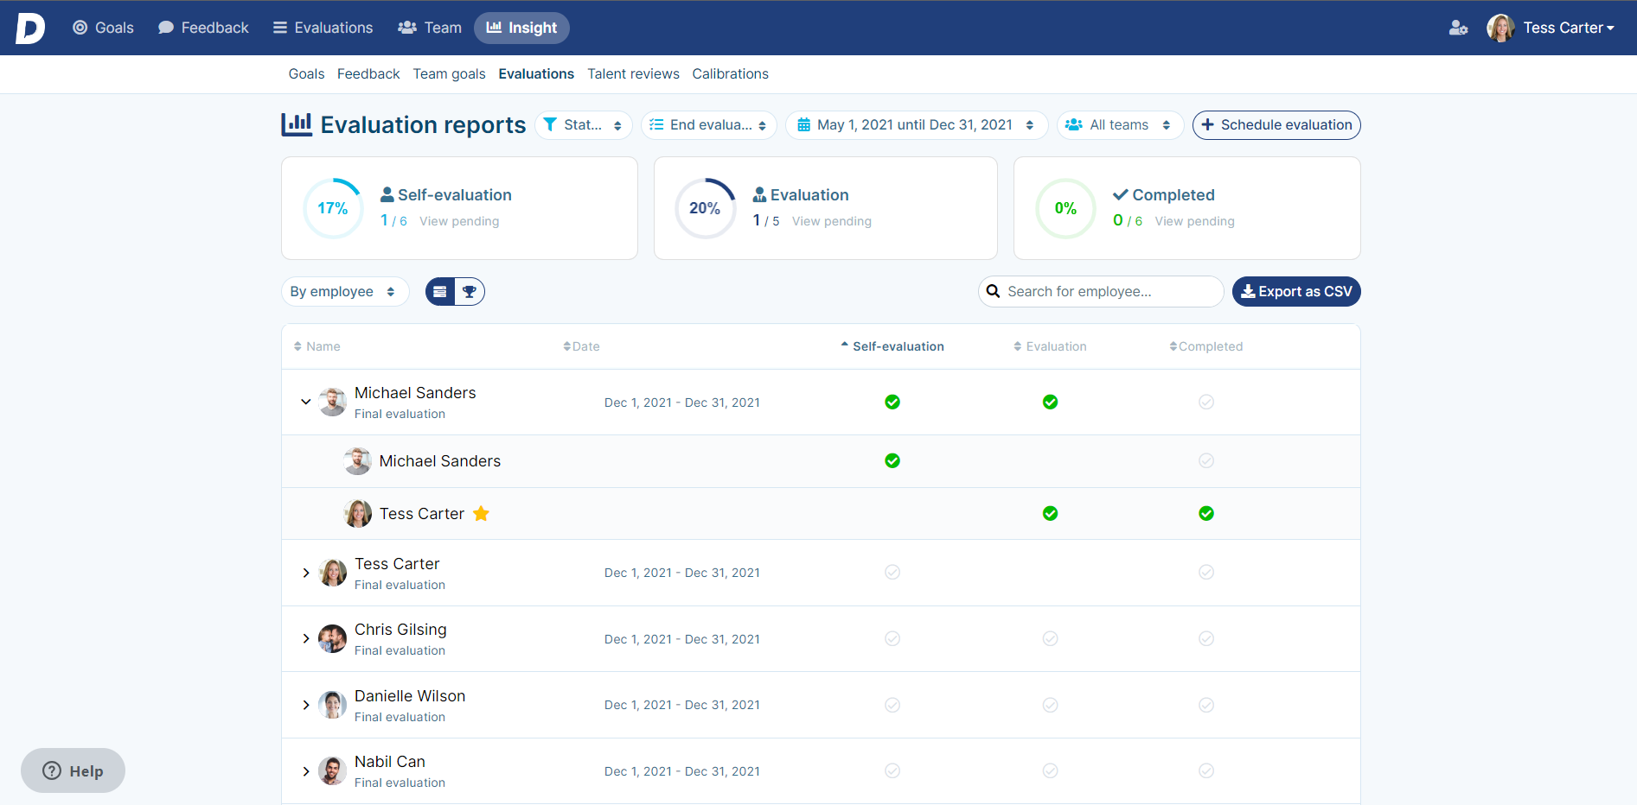
Insight into the activity of your team

Slide 8
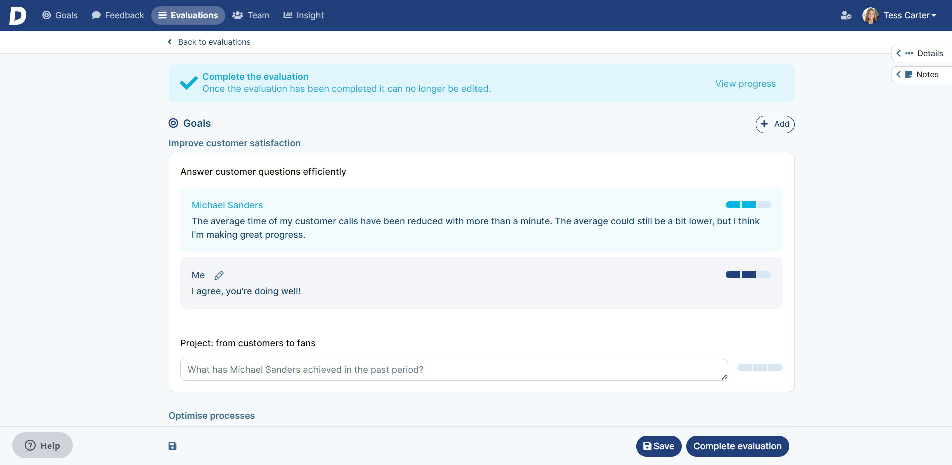
Complete evaluations
After the conversation, you will complete the evaluation.
(Optional: Approved by both the employee and the manager)

Slide 9

Next steps
Scheduling conversations with employees
Handout: 'Evaluations with Dialog'
  Invitation example
  Tips for having the conversation
  Instructions for using Dialog

Slide 10
Questions?

