Slide 1

Evaluation and [ORGANISATION]

Slide 2

Program
Importance of evaluation conversations
Evaluation process and expectations
Evaluation conversations with Dialog
Next steps: prepare conversations
Questions

Slide 3

Importance of evaluation conversations
Basis for personal growth
Increases job satisfaction
Provides you with energy and inspiration for the upcoming period

Slide 4



Evaluation process & expectations
Preparation
Your supervisor schedules an evaluation with you.
Both of you prepare for it through dialogue.
Conversations
You have an evaluation conversation with your supervisor.
Wrap-up
After the conversation, the evaluation is completed.
You incorporate new insights into your personal plan.

Slide 5

Evaluations in Dialog

Slide 6

Preparing for evaluation
Both the employee and the manager will prepare for the evaluation in Dialog.

Slide 7
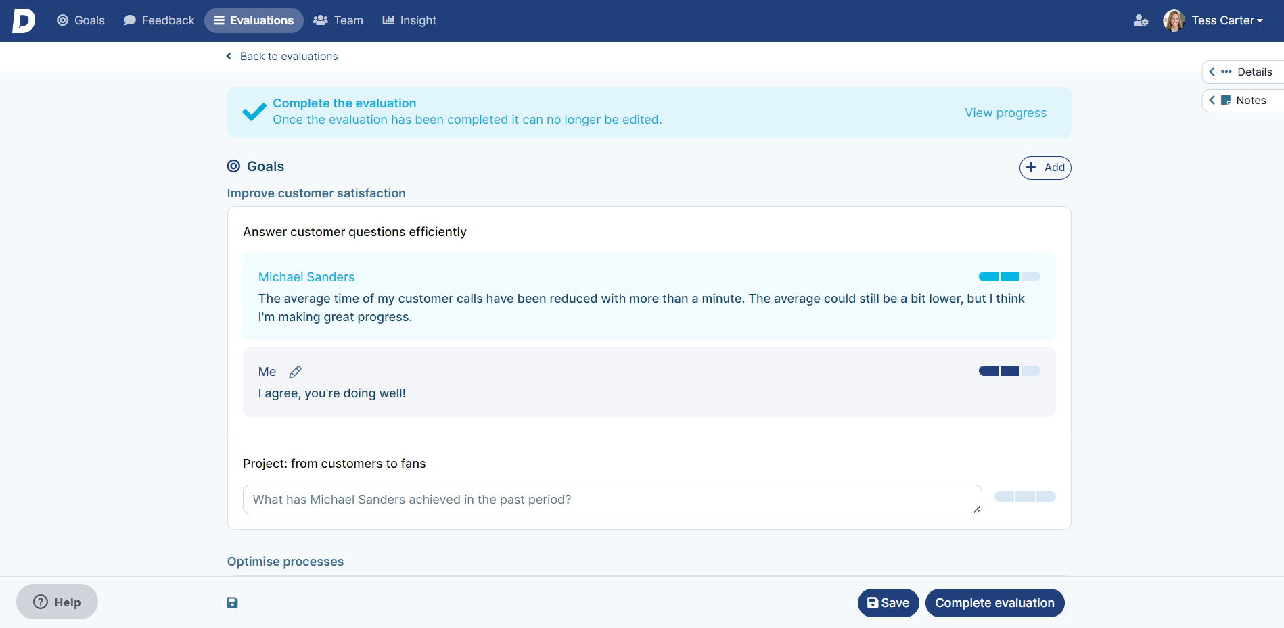
Complete evaluations
After the conversation, your supervisor will complete the evaluation.
(Optional: Approved by both the employee and the manager)

Slide 8

Next steps
Your supervisor schedules an evaluation with you.
You prepare for the conversation by writing a self-evaluation.

Slide 9
Questions?

