Slide 1


Kick-off HR Business Partners
New Performance Management Model

Slide 2
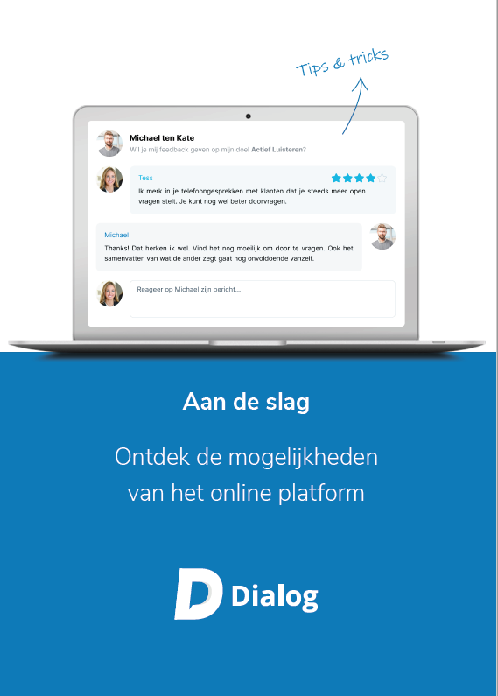

Information
You will receive this presentation
You will receive a 'Getting started’
brochure
AGREEMENT: Creating Q&A’s

Slide 3

Purpose of this session: starting with Dialog
I know what is expected of me
I have a clear plan
I understand well how Dialog works
I am excited about the platform

Slide 4

Programme Kick-off
New Performance Management Model
Dialog support
Getting started
Action plan managers
Follow-up agreements
Sparring (1-on-1 session)

Slide 5
Programme follow-up session
Reflection on kick-off and 1-on-1 session
Q&A new PM model and Dialog
Action plan managers
Action plan HR

Slide 6
New Performance Management Model

Slide 7

Purpose of the HR cycle
10 minutes (plenary)
Why do you have a Performance Management Model?
What is the purpose?
What do you want to achieve?

Slide 8
Purpose of the HR cycle
Encourage personal development
Allow people to do what they are good at
Achieve team and organisational goals
Notes:
Het doel van de HR-cyclus is het verbinden van organisatiedoelen met individuele, persoonlijke doelen van medewerkers/leidinggevenden.
Iedere organisatie heeft een ambitie, wil iets bereiken, heeft doelstellingen. Jij en je collega’s dienen dit voor elkaar te krijgen. Het is en blijft mensenwerk. Echter jij wil ook wat. Jij hebt persoonlijke ambities, persoonlijke doelstellingen, talenten die je wil inzetten. Het verbinden van deze twee belangen, het organisatiebelang en jouw-belang, daar draait het om.

Slide 9

Why are we updating our PM model?
Not connected to daily reality
Process is rigid and coercive
Administrative burden
Takes a lot of time and doesn’t produce results
Does not help people to improve
Goals are not top of mind throughout the year
Limits the taking of responsibility
Manager is in charge and goals are dictated
Notes:
Organisaties die hun HR-cyclus vernieuwen geven vaak dezelfde redenen waarom de huidige cyclus niet werkt. Welke van deze 4 redenen is herkenbaar in jouw organisatie?
Maak de verbinding met Dialog en de volgende slide

Slide 10



What do we want to encourage?
Ownership
We give employees
the confidence to
take the lead
Reflection & feedback
We encourage self-
reflection and feedback, leading to better results
Great conversations
We have a continuous dialogue and support employees during the year
Notes:
Leg de verbinding met Dialog

Slide 11

What does the new HR cycle look like?
January
Proposal for employee's personal plan
Ownership
Employees create a personal plan and take the lead
February
Discuss personal plan
Suggestions and explanation
Change this slide to the customer’s PM model. Here, we outline the customer's formal process.
Reflection & feedback
Employees regularly ask for feedback and reflect
July
Mid Year Evaluation
Great conversations
During each 1-on-1 session we reflect on the personal plan
December
End of Year Evaluation
Notes:
Organisaties die hun HR-cyclus vernieuwen geven vaak dezelfde redenen waarom de huidige cyclus niet werkt. Welke van deze 4 redenen is herkenbaar in jouw organisatie?
Maak de verbinding met Dialog en de volgende slide

Slide 12
Q&A – New PM model
Question | Answer

Slide 13
Dialog support

Slide 14

Create a personal plan
What do you want to achieve?
Performance goals
What do you want to develop?
Development goals
How do you want to be reminded about your plan?
Reminders
Notes:
Je kunt dit (en de volgende drie slides) combineren met het laten zien van de demo.
Je kunt er ook voor kiezen om dit (en de volgende drie slides) eerst te vertellen en dan de demo te laten zien (tell-show-do).

Slide 15
Inspiration for your performance goals
Your current position
What can you do to improve in your current role?
Team and organisational goals
How can you contribute to the goals of your team/organisation?
Personal goals
What else do you want to achieve?

Slide 16

Inspiration for your development goals
Skills and core values
What do you want to develop even further?
Career development
Do you want to take a new step in your career?
Training courses
Do you want to take a training course?
Personal development
Is there anything else you want to develop?

Slide 17

General tips
Focus! Don't start out with too many goals
Set targets you can start working towards now
Break targets down into achievable steps
By making your targets SMART, you increase the chance of success
Set a fixed time to reflect
Keep your plan top of mind and discuss it regularly

Slide 18
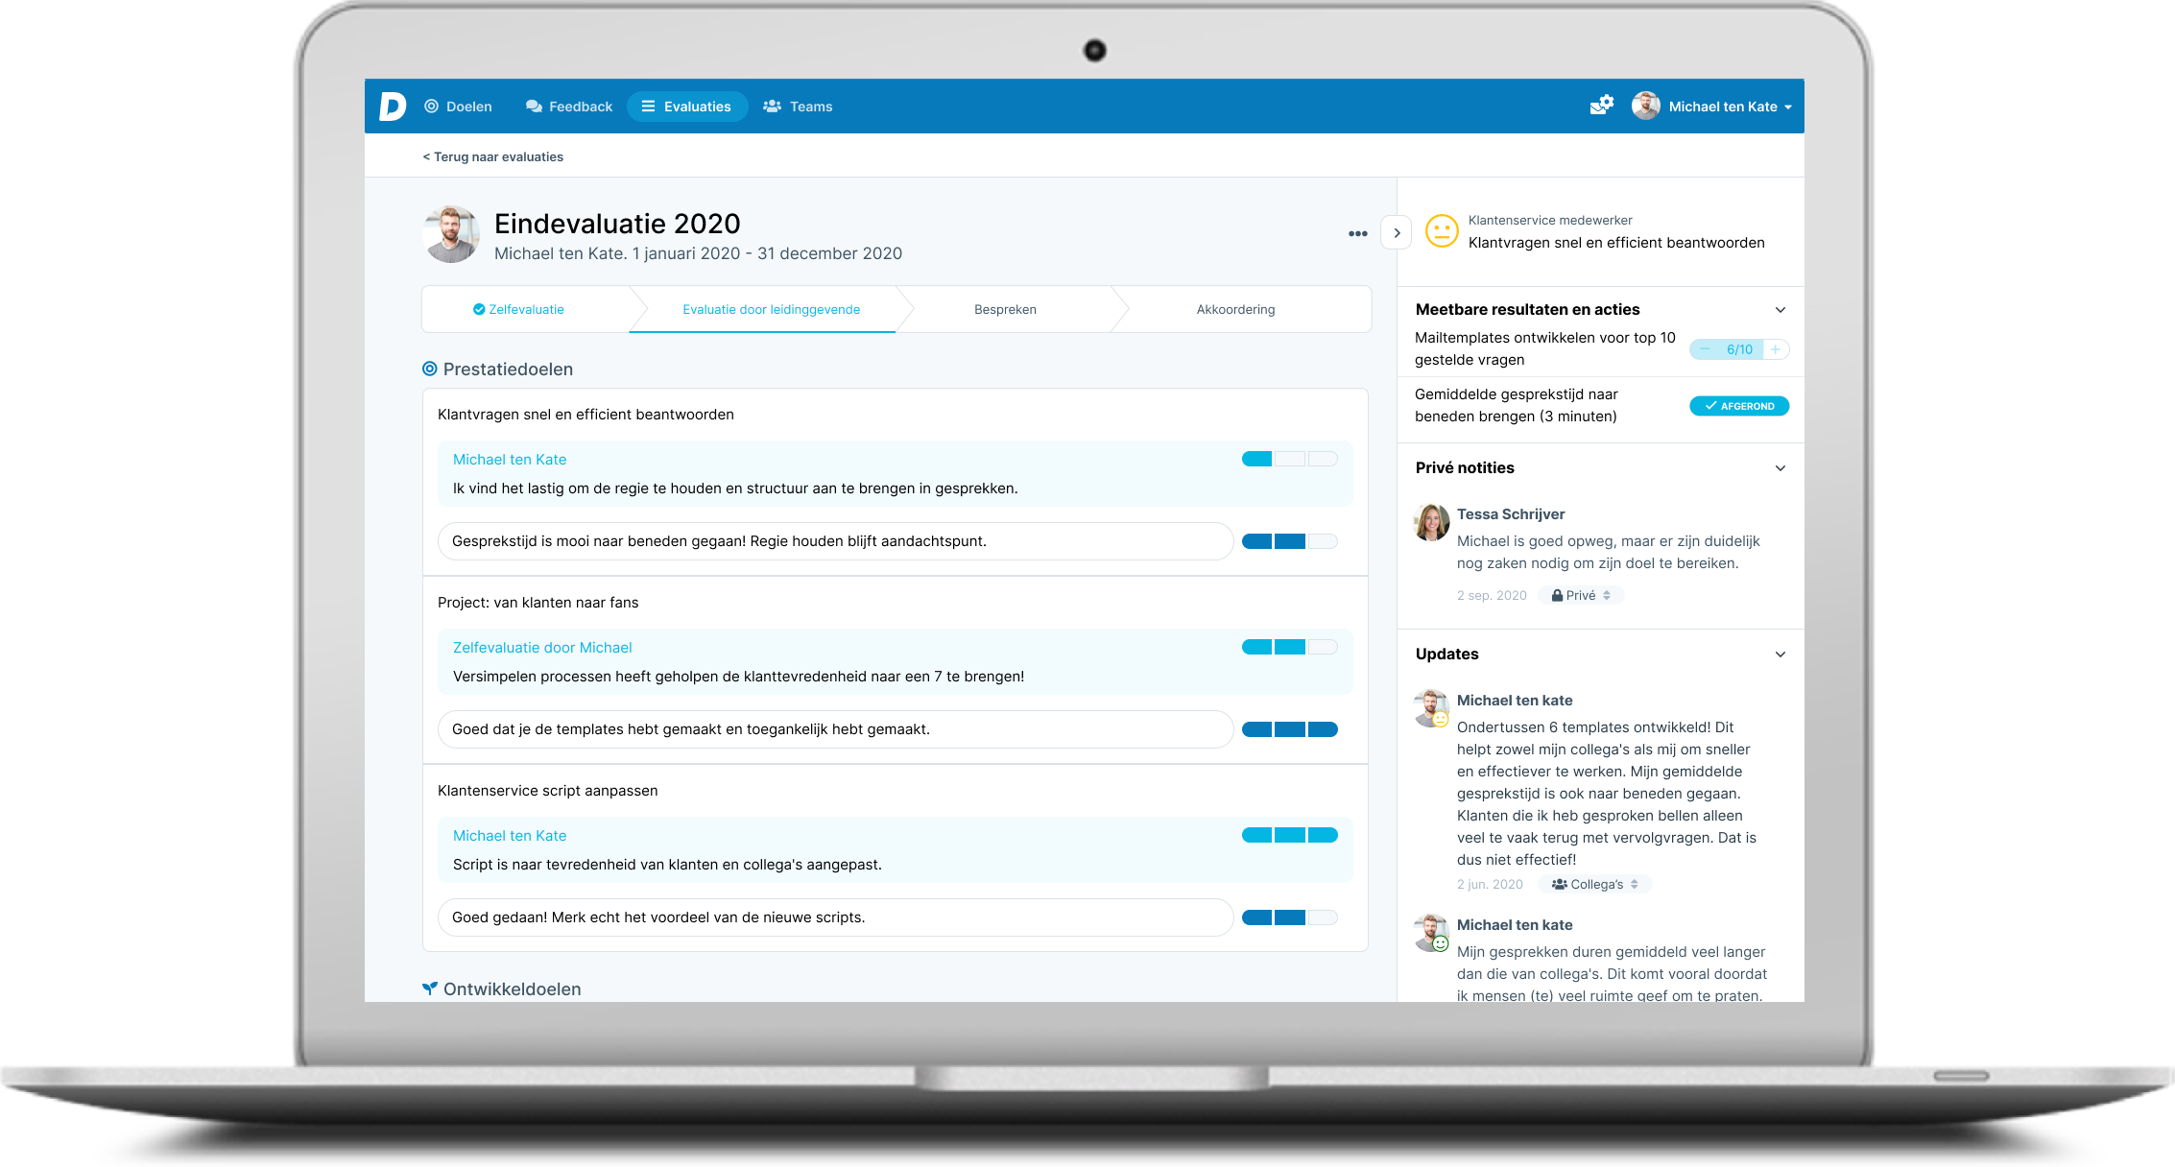
How does Dialog support you? (demo)
Notes:
Laat de demo zien

Slide 19
Q&A – Personal Plan
Question | Answer

Slide 20
Q&A – Reflection & Feedback
Question | Answer

Slide 21
Q&A – Perspective Managers
Question | Answer

Slide 22
Q&A – Evaluations
Question | Answer

Slide 23
Q&A – O
Question | Answer

Slide 24
Getting started
Notes:
Laat de demo zien

Slide 25
Getting started
Register and log in (single sign-in)
Set personal performance goals
Set personal development goals
Reflect on your goals (smileys)
Ask for and give feedback (two people)
Install Dialog on your telephone (see info)

Slide 26
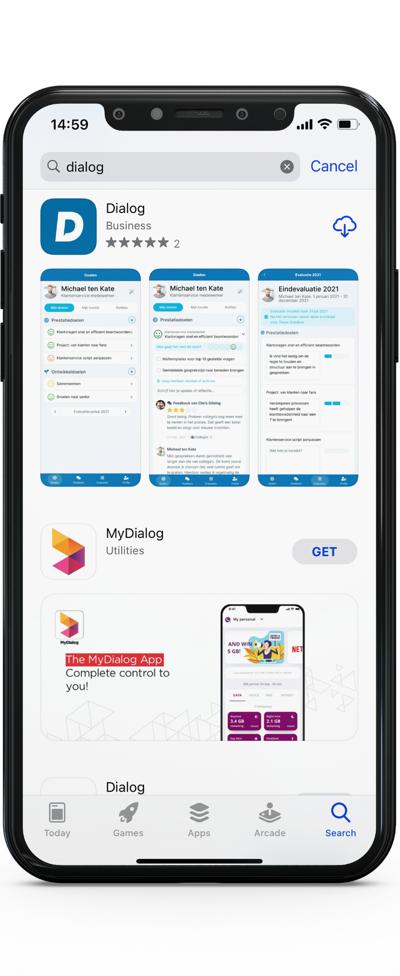
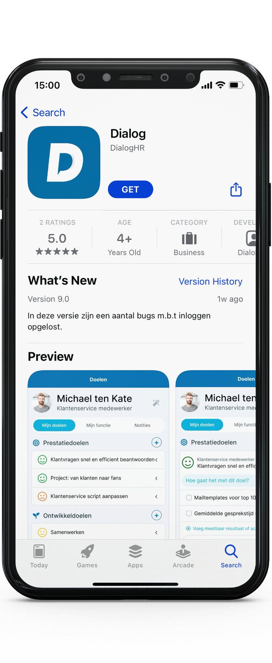
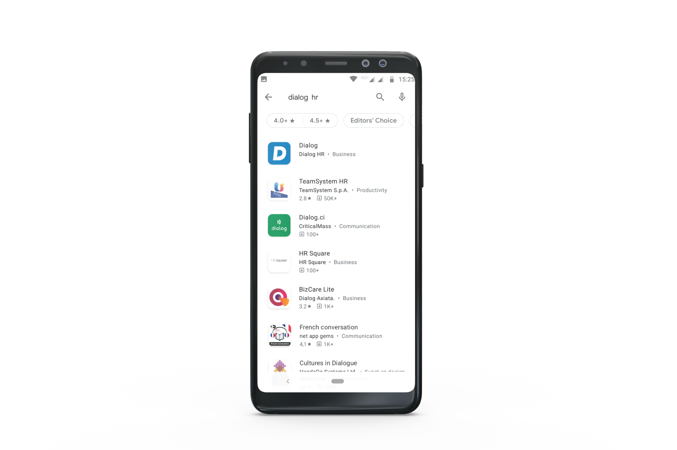
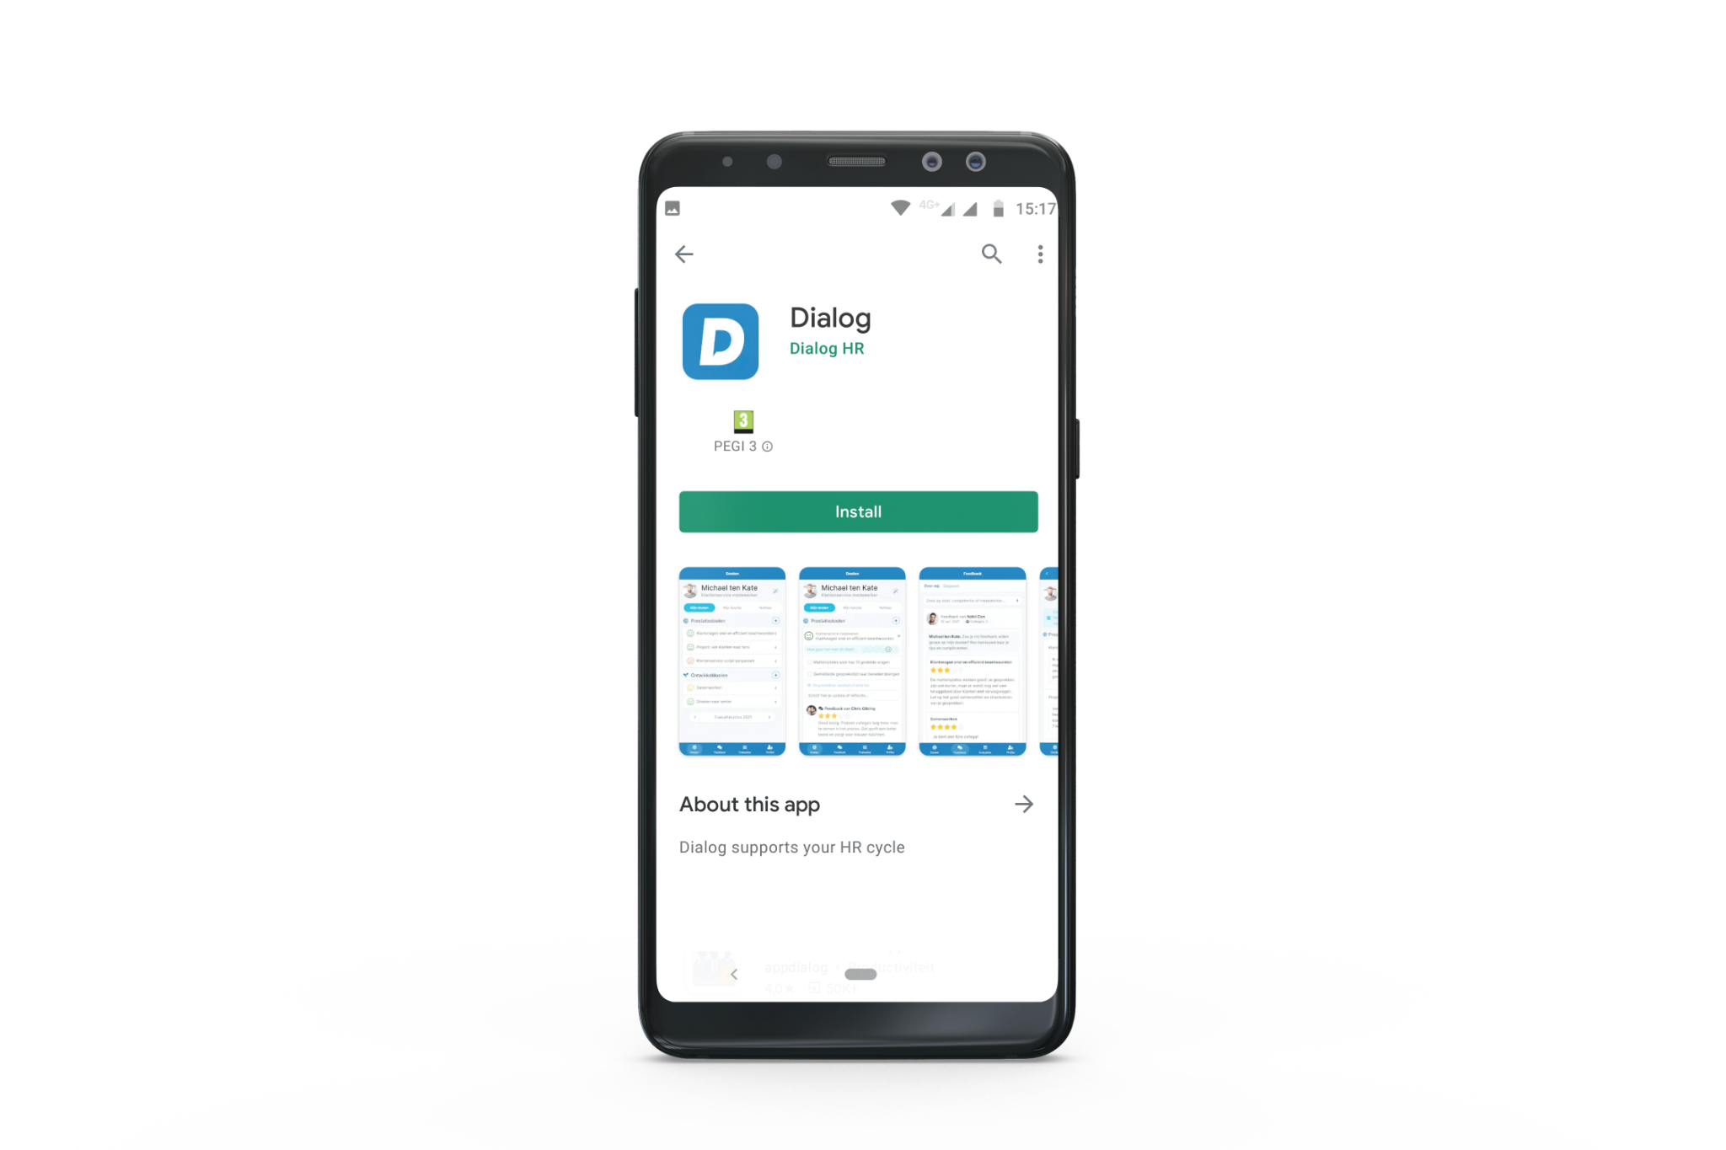

iPhone & iPad
Install on mobile
Android
Step 1
Search in the App Store
for ‘Dialog’
Step 2
Then click on the
‘Get’ button
Step 1
Search in the Google Play Store for ‘Dialog HR’
Step 2
Then click on the
‘Install’ button

Slide 27
Sparring (1-on-1 session online)
Notes:
Laat de demo zien

Slide 28

Sparring (1-on-1 session online)
Do you have any questions about Dialog?
What is your personal plan?
How do you see your role in this project?
Notes:
Wat gaan we doen in de coachingssessies? Ga hier de komende dagen mee aan de slag.

Slide 29
Evaluation
Notes:
Laat de demo zien

Slide 30

Evaluation

Slide 31
Thank you and good luck!
Notes:
Laat de demo zien

