Slide 1

Kick-off Managers
New Performance Management Model

Slide 2
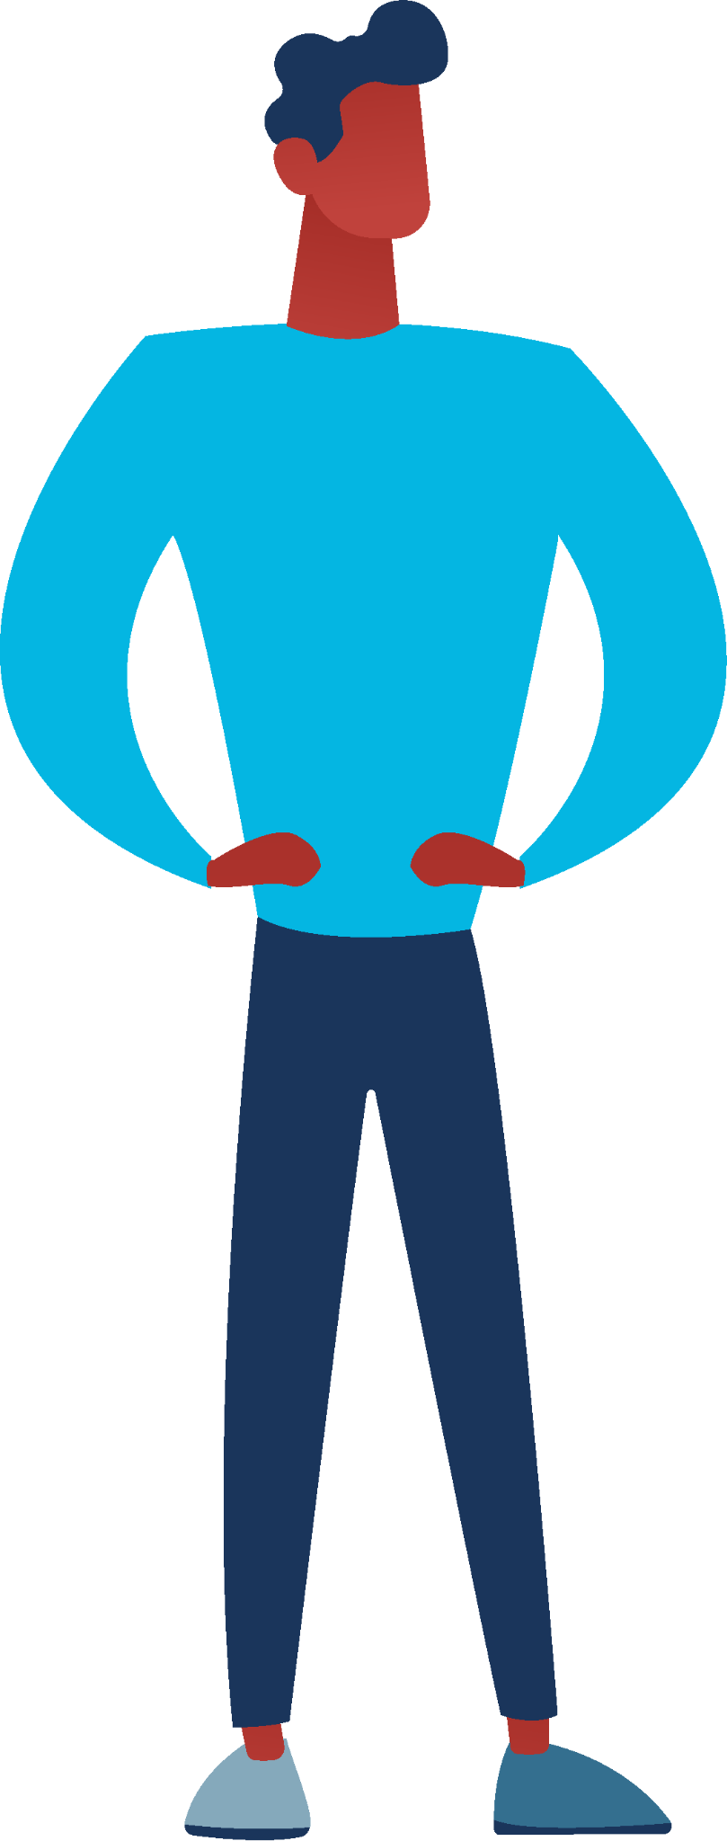

Short introduction by management / HR
!
What are we going to do?
Renewing the performance cycle…
Why are we doing this?
The wish from within the organisation for change…
How are we going to do this?
Supported by Dialog..
Geef kaders mee
Bijv. maak je plan voor datum .. En plan het gesprek met je leidinggevende

Slide 3
Short introduction by management / HR
!
What does the planning look like?
There are sessions in the upcoming weeks…
What do we expect from you?
Getting active yourself…
Where to turn with questions?
Contact HR…
Geef kaders mee
Bijv. maak je plan voor datum .. En plan het gesprek met je leidinggevende

Slide 4


Information during online session
Enable your microphone when you want to speak
Send a chat message when you have questions
Disable mail and phone (reduce disruptions)
You will receive the slides afterwards
You will receive the ‘Getting started’ brochure

Slide 5
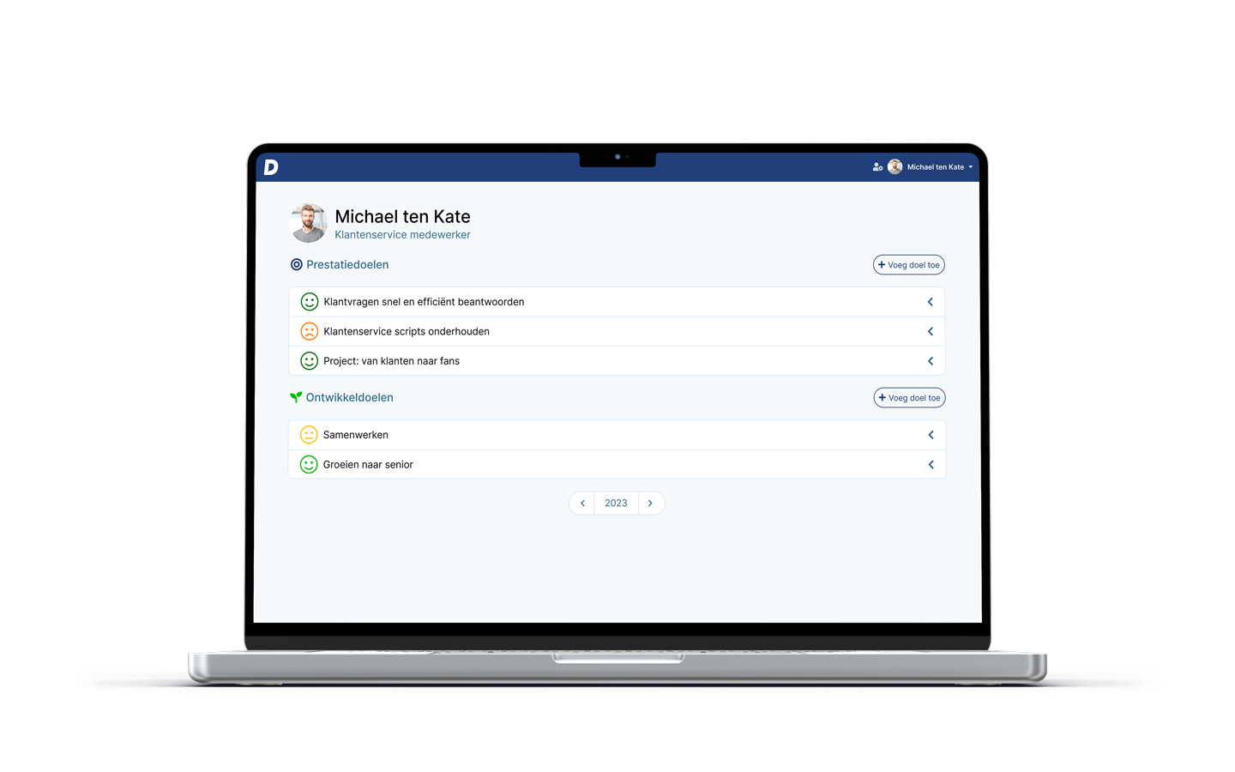


Goal of today’s session: getting started!
You understand how
Dialog works
You want to get started
with Dialog
You started!
You have a personal plan and a clear plan of action for you team.

Slide 6
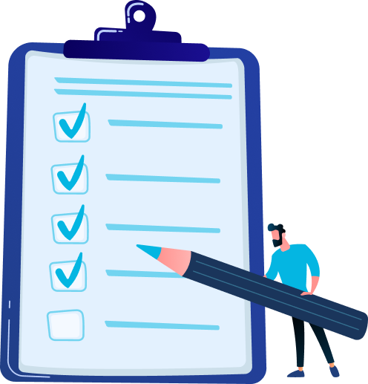
Programme
Why are we doing this? New PM cycle
How does Dialog support this change?
What is expected of you:
  Your personal plan
  Your plan of action for your team
What’s next:
  Kick-off sessions for employees
  Return session

Slide 7

Why are we doing this:
the new performance cycle

Slide 8

Purpose of Performance cycle
10 minuten plenary
Why do we have a Performance cycle?
What is the purpose?
What do we want to achieve?
Een goed gesprek leidt tot:
Gezamenlijk doel
Positieve houding
Echt luisteren
Aannames toetsen

Slide 9



Purpose of the Performance cycle
Encourage personal development
Allow people to do what they are good at
Achieve team and organisational goals
Tekst
Tekst
Tekst

Slide 10
Why are we renewing our performance cycle?
Not connected enough to the daily reality
  Process is rigid and coercive
Administrative burden
  Takes a lot of time without producing results
Does not help people to improve
  Goals are not top of mind throughout the year
Limits responsibility and ownership
  Manager in charge and goals are dictated

Slide 11



What do we want to encourage?
Ownership
Reflection & Feedback
Great conversations
We entrust employees with the responsibility to take the lead
We encourage self-reflection and feedback leading to better results
We have a continuous dialogue and support employees during the year

Slide 12

What does the new Performance cycle look like?
January
Proposal employee’s personal plan
February
Discuss personal plan
July
Mid year evaluation
December
End year evaluation
Ownership
Employees create a personal plan and take the lead
Reflection & feedback
Employees regularly ask for feedback and reflect on their progress
Great conversations
During each 1-on-1 session we reflect on the personal plan
Suggesties & toelichting
Pas deze slide aan aan de cyclus van de klant. Hier omschrijven we het formele proces van de klant.

Slide 13
How does Dialog support this change?

Slide 14
Make a personal plan
What do you want to achieve?
  Performance goals
What do you want to develop?
  Development goals
How often do you want to be reminded?
  Set reminders

Slide 15

Inspiration for your performance goals
Your current job / position
  What can you improve in your current position?
Team and organisational goals
  How can you contribute to these goals and objectives?
Personal goals
  What else do you want to achieve?

Slide 16

Inspiration for your developmental goals
Skills and core values
  What do you want to develop (even further)?
Career development
  Is there a next step in your career to work towards?
Personal development
  Are there other areas or skills that you like to grow in?

Slide 17
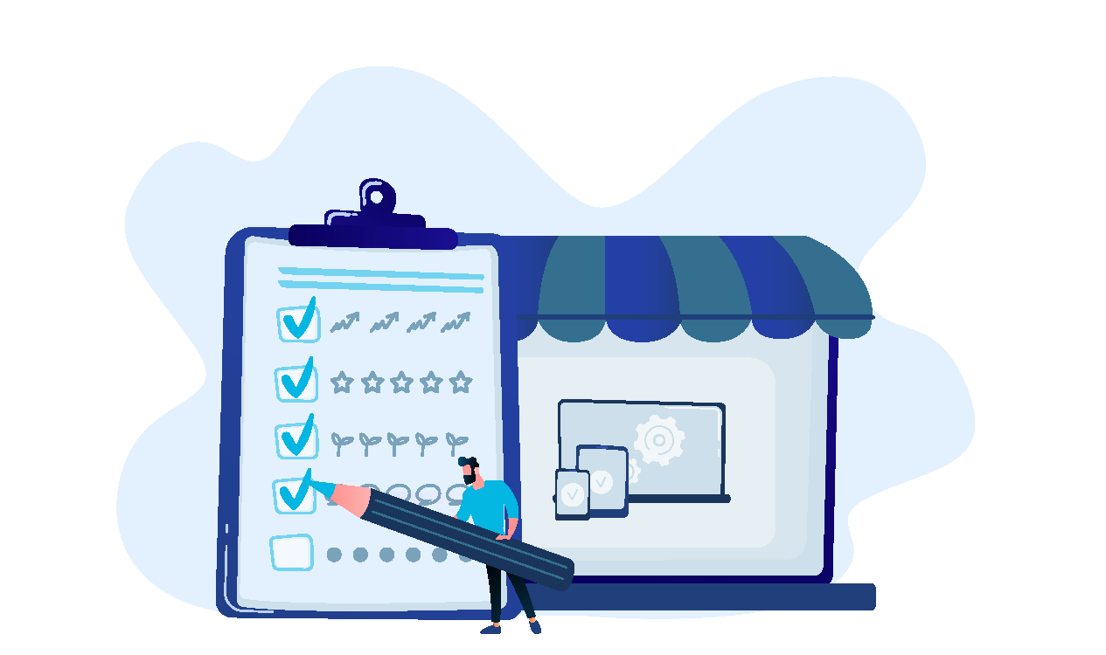
General tips
Focus! Don’t start out with too many goals
  Which 3-4 goals are relevant now?
Break it down into achievable steps
  By making goals SMART you increase chance of success
Set a fixed time for reflection
  Keep your plan top of mind

Slide 18
How does Dialog support you and your team?
DEMO

Slide 19
What is expected of you:
your personal plan

Slide 20
Set your own goals
Set 2 performance goals
Example:
  I want to support the usage of Dialog in my team
    100% of my team has a personal plan
    All team members ask feedback monthly
    100% of my team finishes the review round

Slide 21
Set your own goals
Set 2 development goals
Example:
  I want to improve my feedback giving skills
    I give feedback to my team members monthly
    I give compliments more frequently
    I don’t shy away from giving constructive feedback

Slide 22
Getting started with Dialog
Register and log in (single sign-on)
Set at least 1 personal performance goal
Set at least 1 personal development goal
Set at least 1 team goal
Reflect on your goals (using the smileys)
Ask for, and give feedback at least once
Optional: install the Dialog mobile app

Slide 23

Problems logging in?
Send an email to: support@dialog.nl
Mention your HR manager [mail] on cc
Make a fullscreen screenshot
Explain the steps you undertook

Slide 24
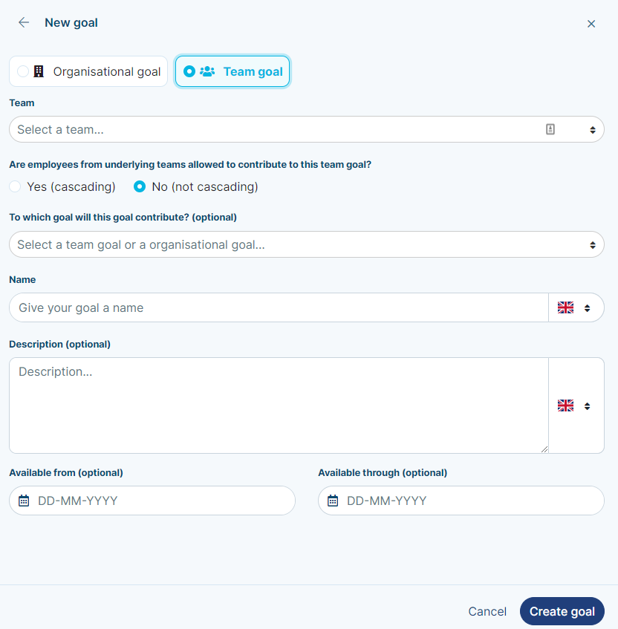
Team goals
Add team goal
Select which team it applies to
Determine who can contribute
  Only the selected team
  + All underlying teams
Provide a short and recognizable goal name
Optional: Determine the period of time this goal is relevant to the team

Slide 25
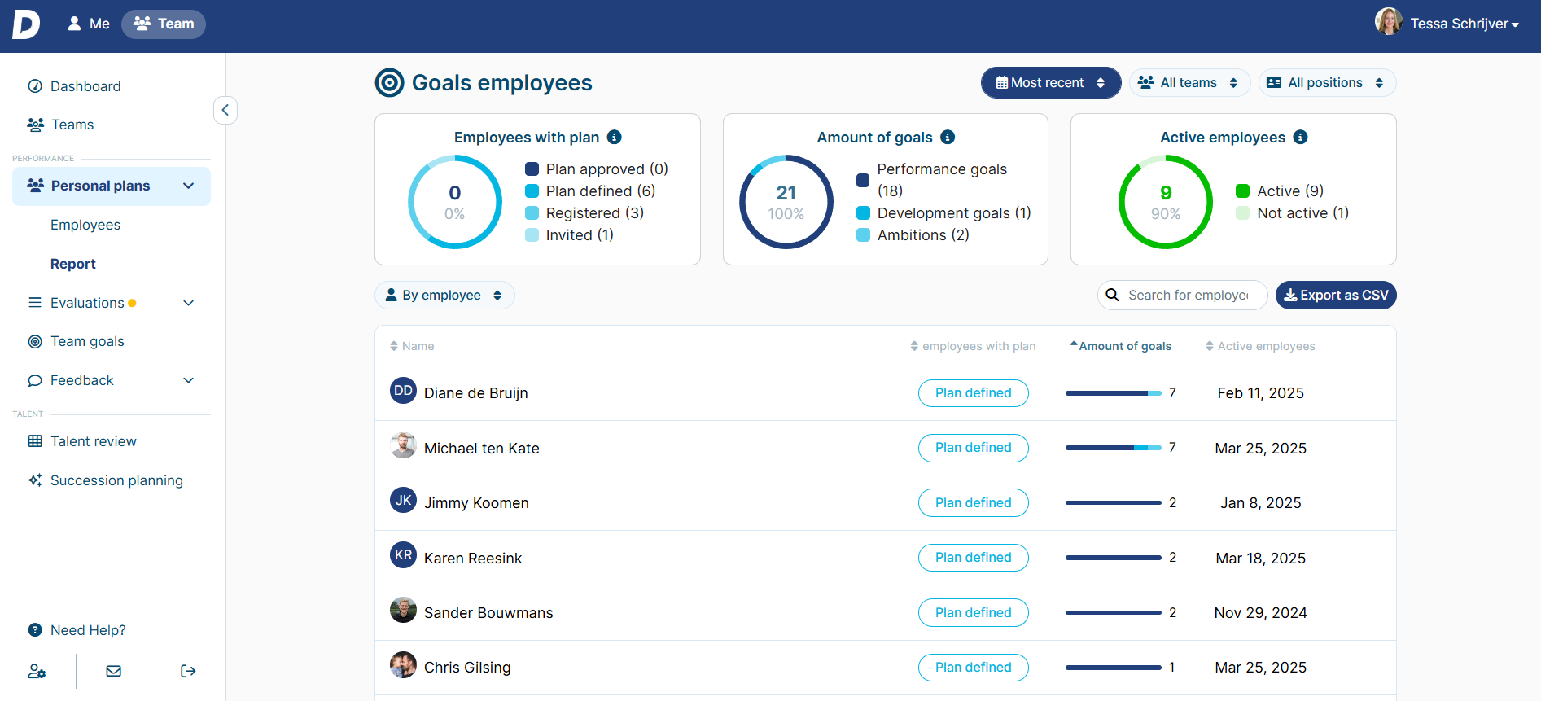
Insights into the activity of your team

Slide 26
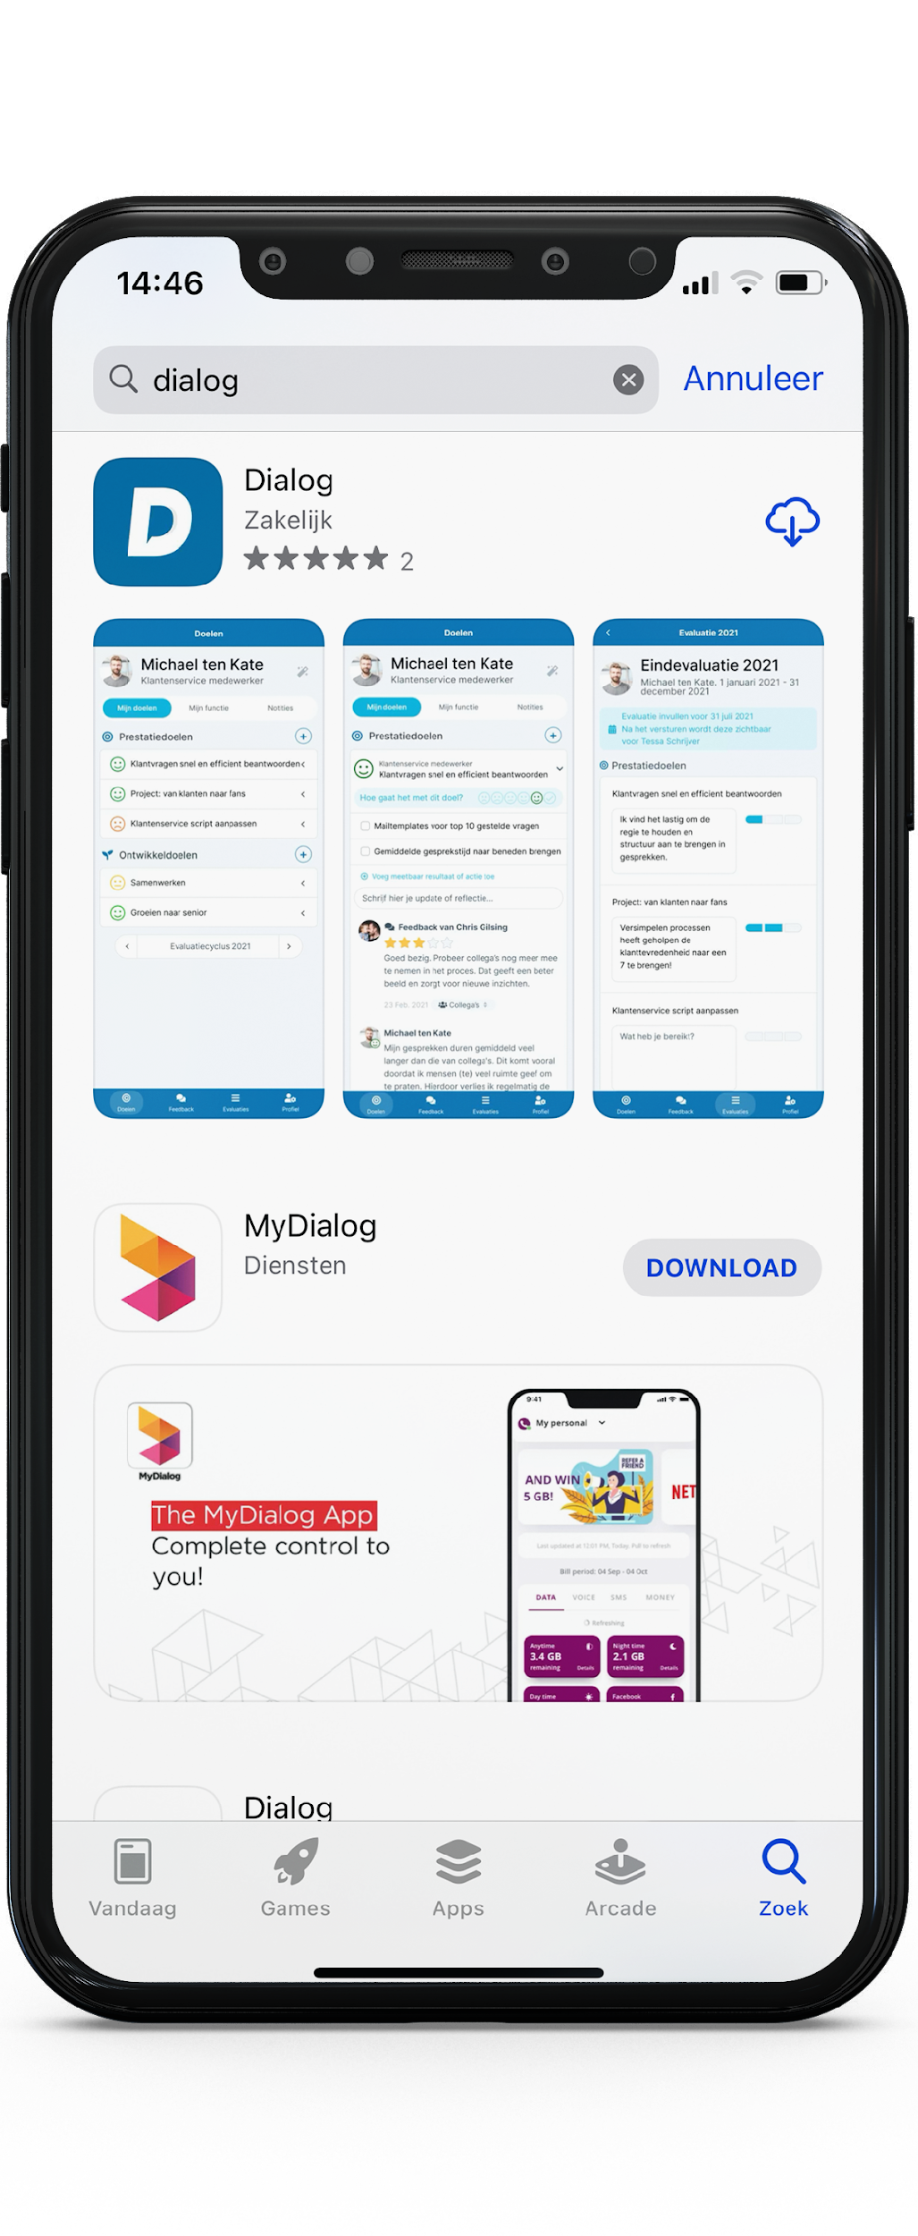
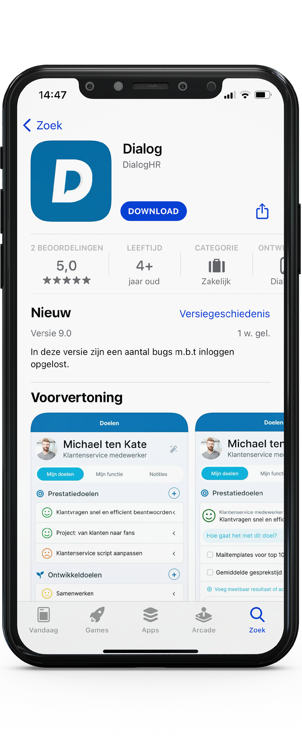
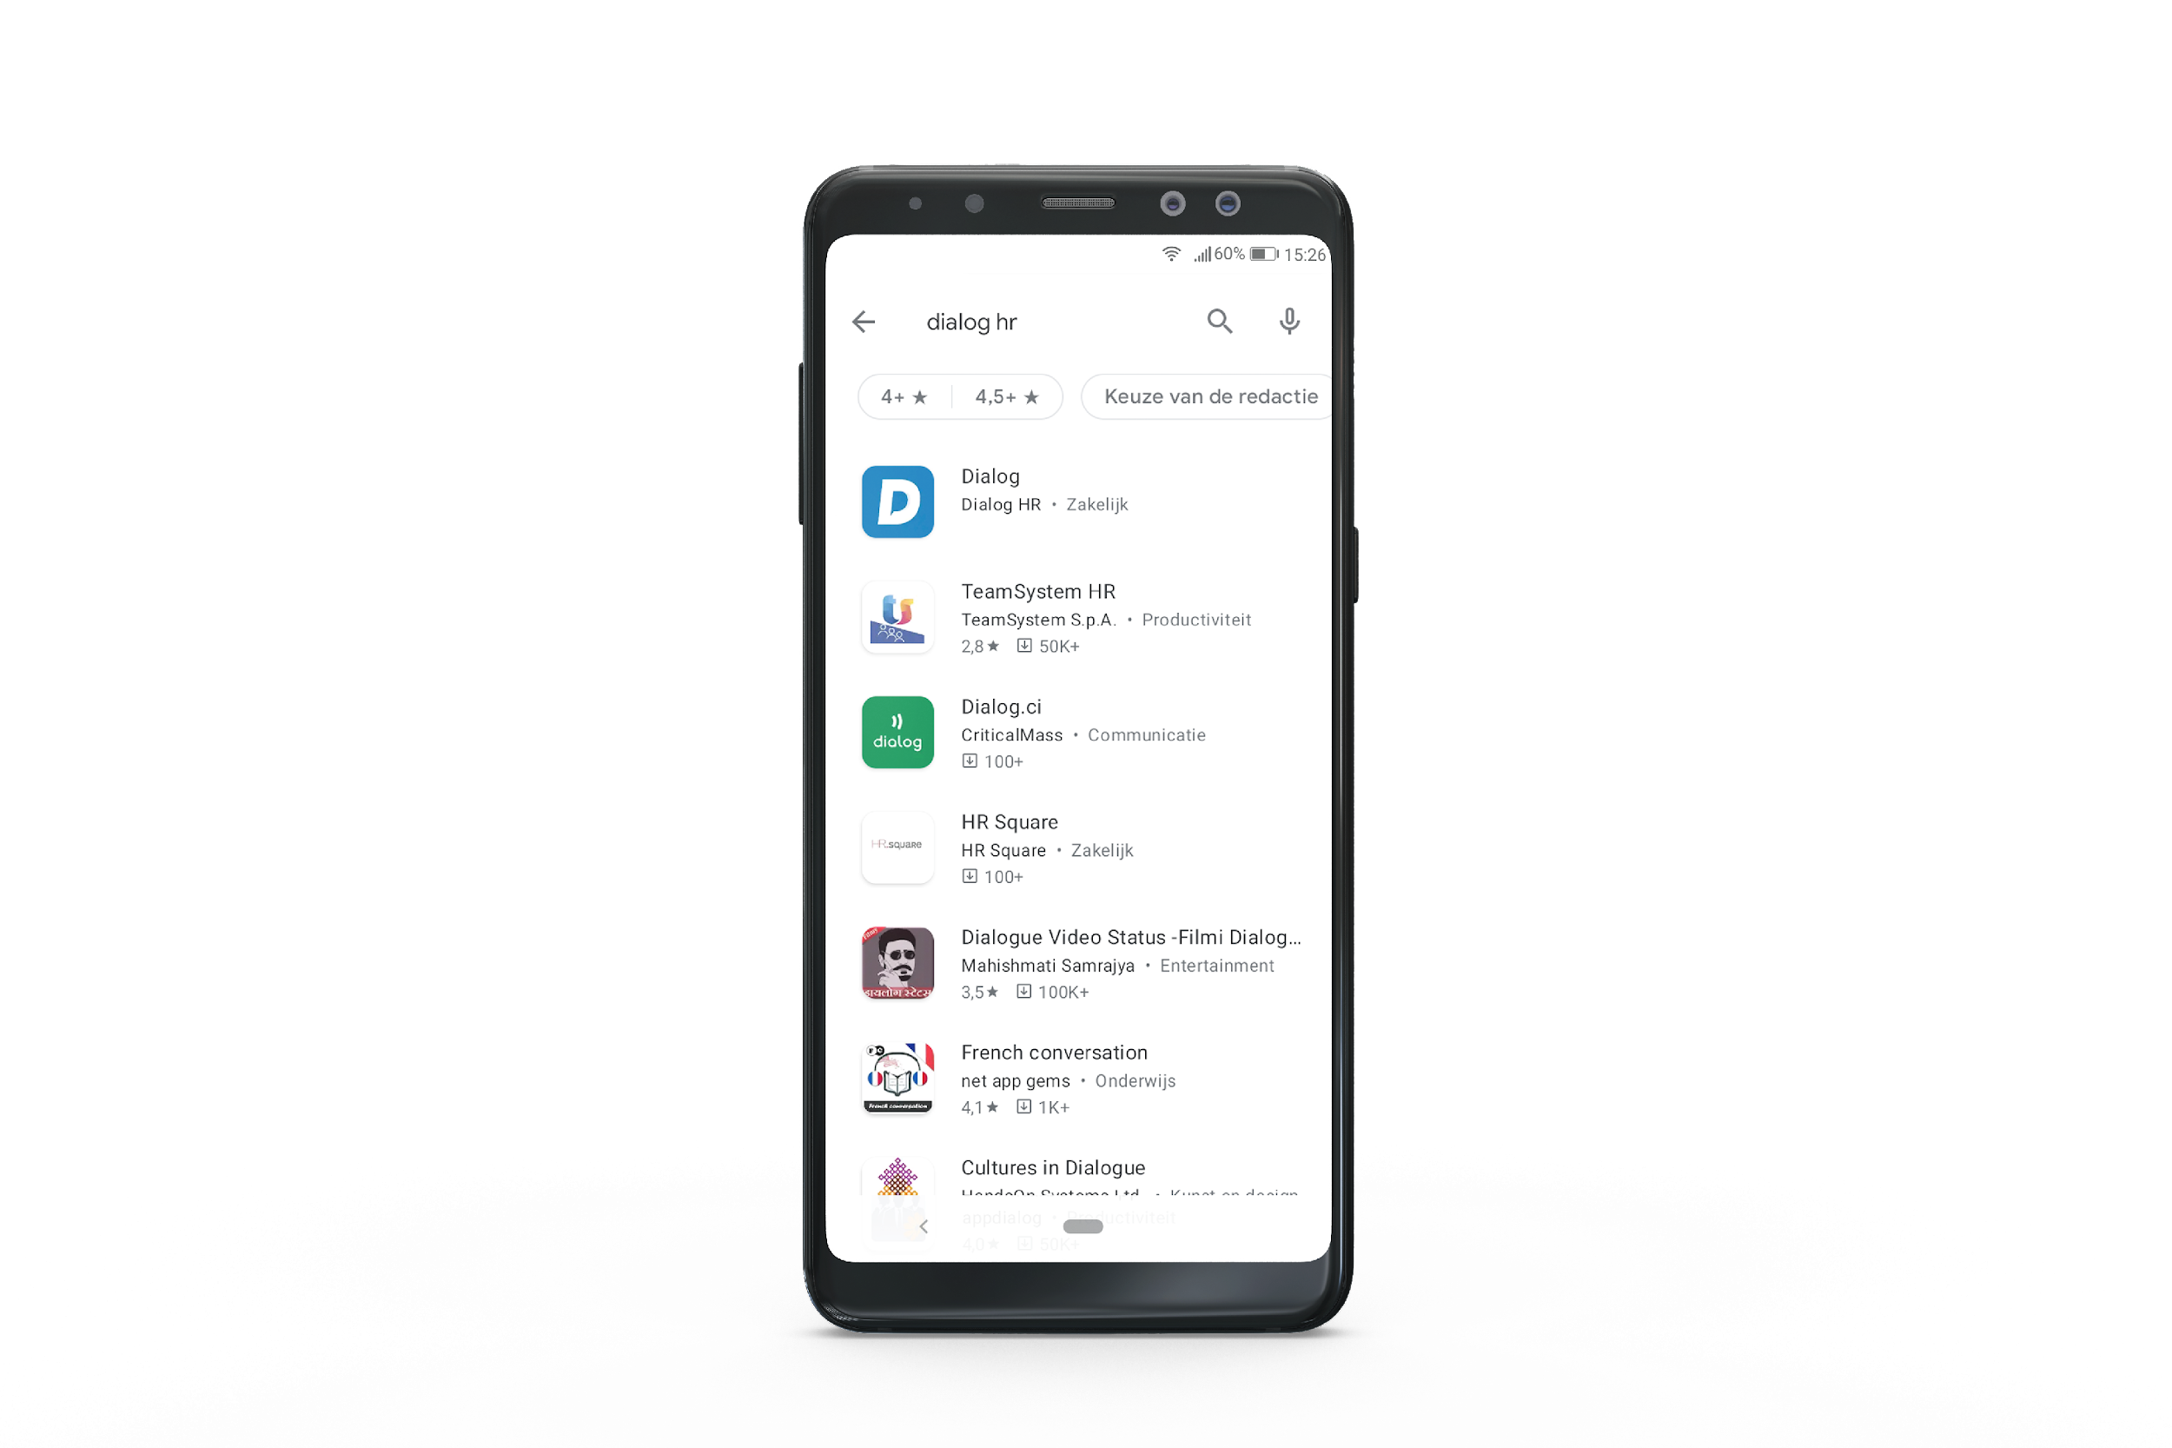
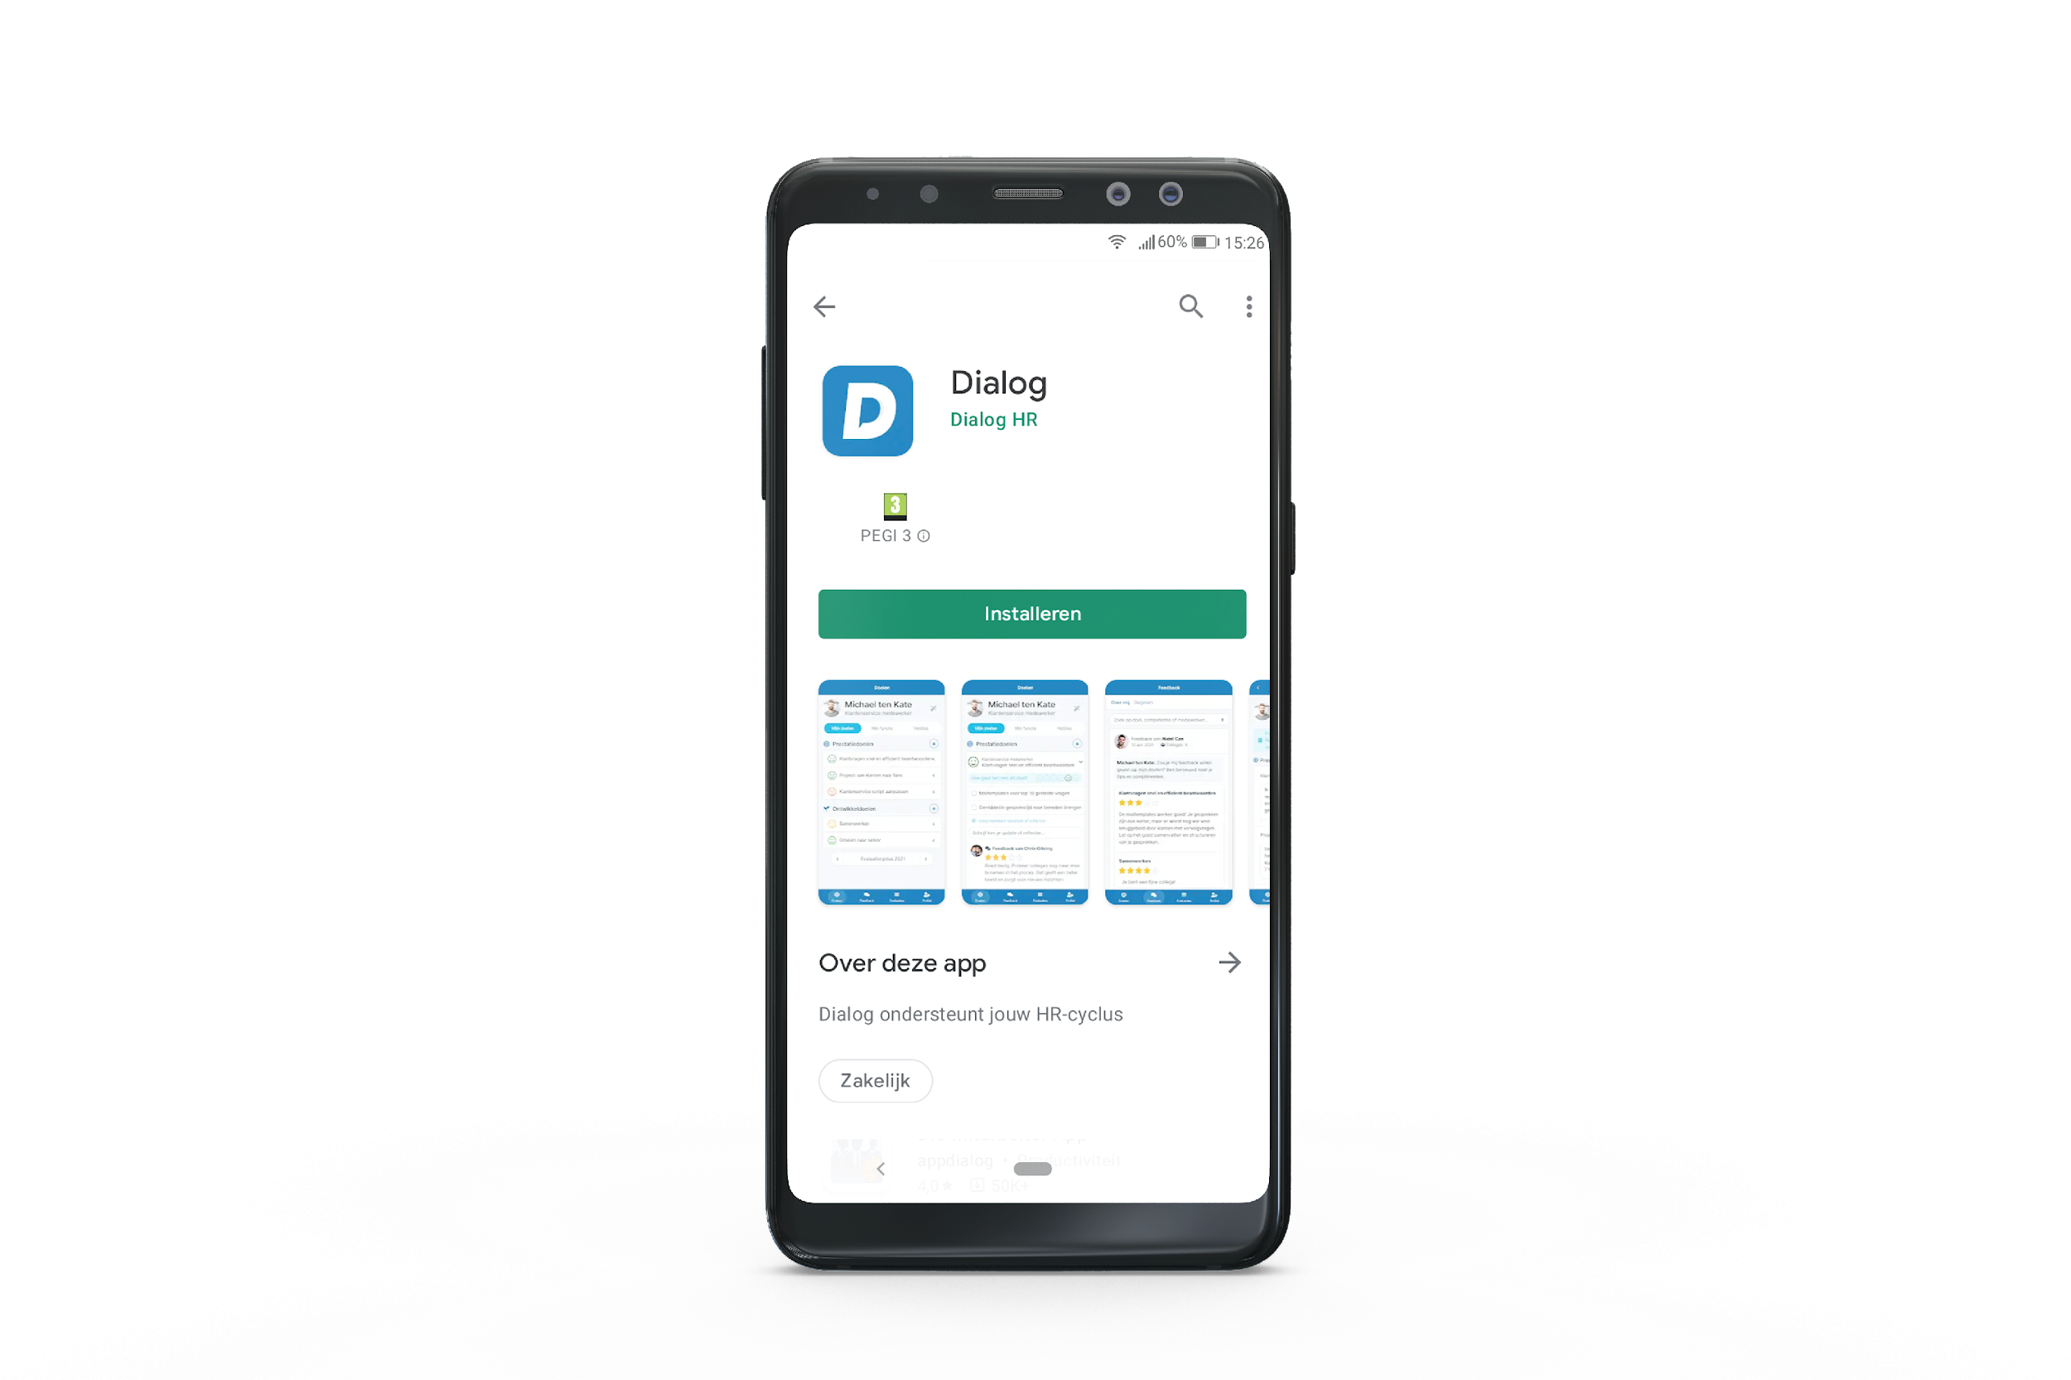
Install on smartphone
Iphone
Android
Step 1
Search the App Store
for ‘Dialog’
Step 2
‘Download’
Step 1
Search the Google Play Store for ‘Dialog HR’
Step 2
‘Install’

Slide 27
What is expected of you:
plan of action for your team

Slide 28
Plan of action for your team
10 minutes independent + 20 minuten plenary
Plan the teamsessie (introduction)
Agreements and expectations
Impact op 1-on-1’s, team sessions etc.
Feedback: how should this be incorporated?
Een goed gesprek leidt tot:
Gezamenlijk doel
Positieve houding
Echt luisteren
Aannames toetsen

Slide 29
Checklist
Team session planning (day - time)
Create presentation for team session
Schedule date when personal plans are ready
Schedule dates for calls to discuss these plans
Agree how to use Dialog during 1-on-1’s
Agree on how to use Dialog during team meetings
Communicate what employees can expect from you
Communicate what you expect from your employees
Determine how you will stimulate giving/requesting feedback

Slide 30

What’s next?

Slide 31
Kick-off sessions for employees
When are these sessions scheduled?
Managers should also attend
Managers should participate actively
Speaking out about expectations
  Show your own personal plan
  Role model: lead by example!

Slide 32
Return session
1 months after employees have started
How is using Dialog within your team?
Does everyone have a personal plan? Do you?
How are the conversations going?
What goes well, what could be better?
What questions do you still have about Dialog?
How will you use Dialog in your way of working?
What is the next step?

Slide 33

Next steps
Personal Plan
Plan of action team
Return sessions
Determine what you want to achieve and develop and document this in your
personal plan
Determine how you will engage with your team and how you will stay engaged with them
Determine what else you
want to discuss during the return session

Slide 34

Evaluation

Slide 35
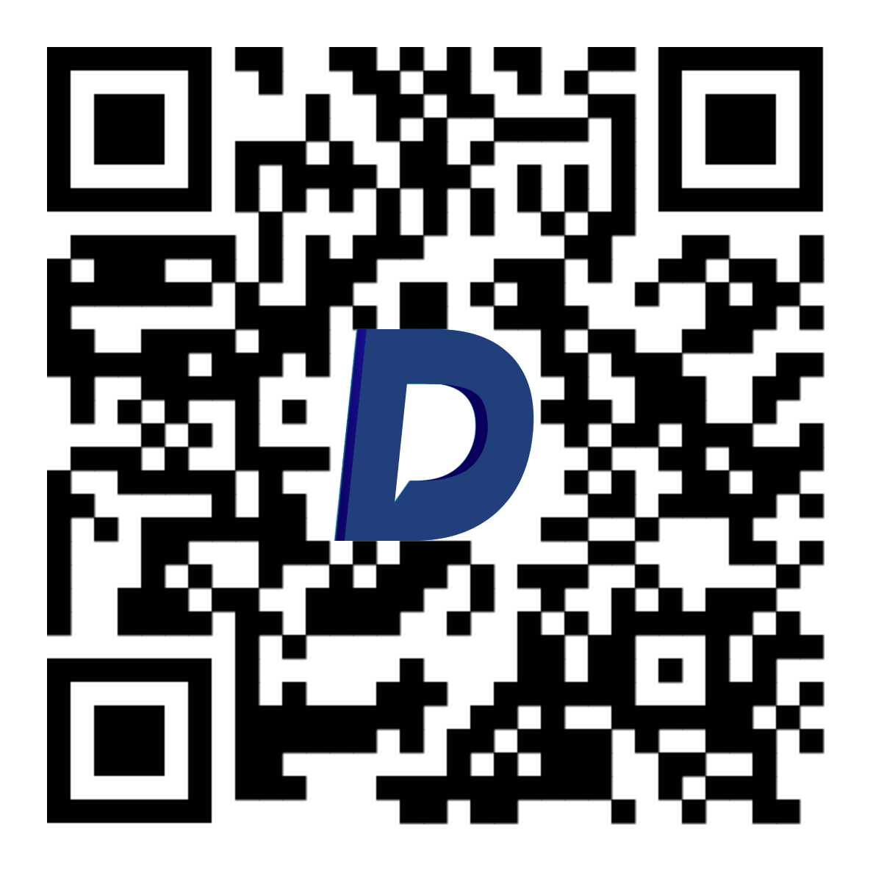
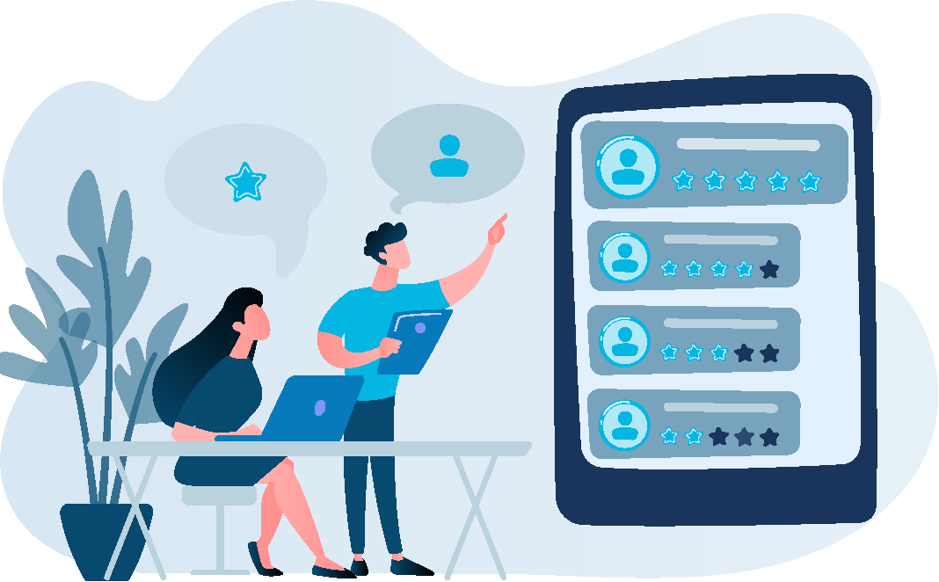
Evaluation - 6 questions
Naam

Slide 36
Evaluation
I know what is expected of me
I have a clear plan for my team
I understand how Dialog works
I am motivated to start using Dialog

Slide 37

Thank you & have fun getting started!

