Slide 1

Continues improvement session setting goals

Slide 2
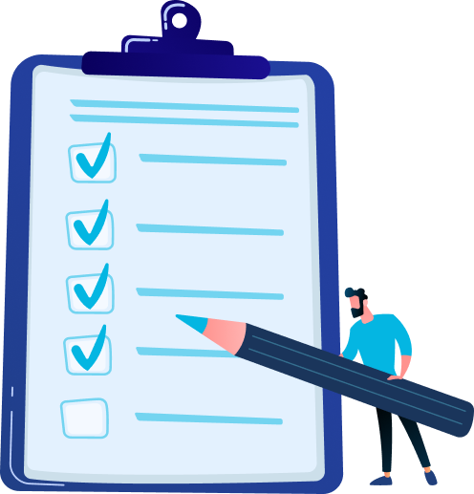
Goal of this session
Learning together:
  How did the goal-setting period go?
  What went well?
  What can be improved?

Slide 3
Continues improvement - setting goals
Do all of your employees have a personal plan? How many do/ don’t?
What did you do to support your employees?
What helped you with this?
Answer | Possible learning point

Slide 4
Continues improvement - setting goals
What were the challenges in supporting the employees?
What needs are there to better support the employees in this regard?
Answer | Possible learning point

Slide 5
Continues improvement - setting goals
What agreements have you made to have a continuous conversation with your employees about their goals?
Answer | Possible learning point

Slide 6
Continues improvement - setting goals
How was the support from Dialog in goal-setting? Consider:
  The job profile
  The organisational and/or team goals
  The competencies and/or core values
  The additional development questions
Answer | Possible learning point

Slide 7
Continues improvement - personal plan
What could we have done better to support you in this?
What could you have done better to support your employees in this?
Answer | Possible learning point

Slide 8
Continues improvement - personal plan
Is there anything else you would like to add?
Answer | Possible learning point

